Slide 1
NOACSC Annual Membership Meeting
November 10, 2016
Wireless Access:
SSID: campusguest
Password: ichooseapollo

Slide 2
Welcome
Ken Amstutz
Superintendent, Van Wert City Schools
Chairman, NOACSC Board of Directors

Slide 3
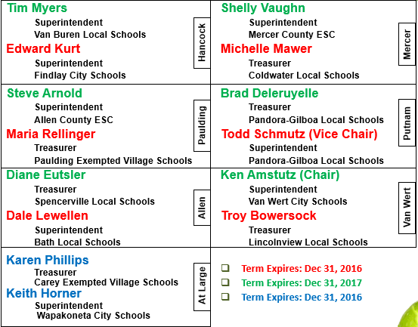
Board of directors
Karen Phillips replaced Christy Beaschler as the At-Large Treasurer
Steve Arnold – the Paulding County Superintendents are OK since he will be Western Buckeye Superintendent April 1, 2017
Board Members in Red and Blue term expires the end of December, Ray will be contacting the ESC’s

Slide 4
Director’s address
Ray Burden
Executive Director

Slide 5
agenda
Organization Chart – New Staff
New Member of Cooperative
Financials
Fiscal ERP Project – MUNIS
New Location of the Cooperative
Security
Software Answers
DEMO Virtual Classroom and DataMap
Closing

Slide 6
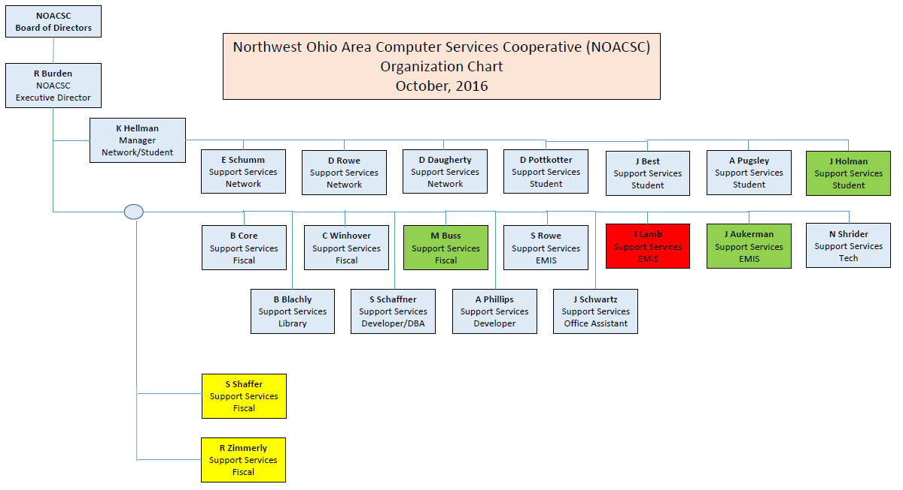
Organization Chart

Slide 7
New member
Eastwood Local Schools
Brent Welker, Superintendent
Brad McCracken, Treasurer
Matt Routson, Tech Director
Wood County
Now at 55 members

Slide 8
Financial status
Fiscal Year 2016

Slide 9
Balance
Notes:
Our ending balance is currently $2,577,397
+418,450 from FY14
Our ending balance is currently $2,158,947
+140,983 from FY13

Slide 10
Expenses
Notes:
+44,830
**office supplies has software agreements – used to move to purchased services –

Slide 11
2016 Expenses
Notes:
85/95 percent of our expenses are essentially locked in.

Slide 12
Revenue
Notes:
OtherNetwork:
aSc
Kace
Server Hosting
Web Hosting

Slide 13
2016 Revenue
Notes:
Basic 1% INFOhio 3%
Fiscal 4% ISP 42%
EMIS 4% State 9%
Student 21%**(PB, Student, SPS, IEP, Schoology)
Other 16% (email, archiving, admin, Moodle, voip, etc)

Slide 14
Fiscal ERP Project - munis
Wave 1: Paulding, Lima, Bath, Antwerp, Vantage, NOACSC
Not just Pilots – Pioneers, Trailblazers
Staff solves problems
Brenda Core, Carolyn Winhover, Michelle Buss
Capacity and Effort
Sherry Shaffer and Rhonda Zimmerly
Go Lives
NOACSC: January, 2017
Antwerp, Bath, Paulding, & Vantage: February, 2017
Lima moved to July, 2017
Wave 2
Arcadia
Marion Local
Pandora-Gilboa
Celina
Van Wert
Fort Recovery
Start Wave 2 Planning in Late November
ON HOLD

Slide 15
Munis – next steps
Notify Tyler of the decision to place the project on hold
Determine the financial impact of this decision
Present the above to the NOACSC board and the districts who have committed to MUNIS for their decision
Timeline is unknown

Slide 16
State Software - Redesign
Discussion with Jodi Becher – SSDT USAS Project Manager
Redesign – “Not Ready yet”
Release Candidate in January, 2017
Load into Test Environment at NOACSC
District(s) testing
Provide Feedback to SSDT
Go –live is up to each district individually

Slide 17
Fiscal Erp - Sungard
MCOECN has contract with Sungard
Currently 15 Districts state-wide implementing Sungard
Projected go-live is January, 2017
Scott Waltour is Project Manager for MCOECN
Process begun with Scott
Meeting with Scott and Sungard
Demo
Potential visits to implemented districts
Costs/Fees and Contracts

Slide 18
NOACSC – New Location
4277 East Road – Lima
Design/Build for Remodeling
Muhlenkamp Builders from Coldwater
6 month project from Oct, 2016 thru March, 2017
Improved Training Capacity
Kitchen/Break Room
Restrooms

Slide 20
645 South Main Street
Building sold in October
Local Investor
Leasing until we move
New Tenant will be Benchmark
Elderly Services

Slide 21
Security
Hearing/Reading about this quite a lot these days
Concerned about security fatigue
Perpetrators are Amateurs and Professionals

Slide 22
October 21 - Amateurs
Mirai Malware posted on Hackforums
Most likely “script kiddies”
Dyn – A major DNS hosting company
They interpret 198.38.96.0 to www.netflix.com (vice versa)
And thousands of others
Fortunately NOACSC and Districts were relatively unaffected except for access to attacked sites
Used Internet of Things (IoT)
DVR’s, Webcams
Default Admin/Passwords

Slide 23
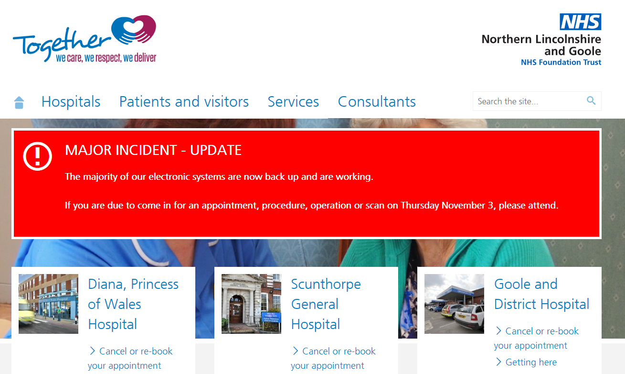
October 30 – the pros
Virus Attack – probably Ransomware

Slide 24
Why you should be concerned
Two important databases: Student and Staff
1 in 5 breaches is electronic
Ohio’s OECN (ITCs) provides added layers of electronic security
Firewalls
Intrusion Protection and Detection/Anti-Virus
Subject Matter Expertise and Assistance
Districts provide their own layers of electronic security
So what about the other 4 in 5?

Slide 25
security
4 in 5
Staff make mistakes
Disgruntled employees
Failure to follow procedure
3rd parties with lax or meager security measures
80% of our time on 20% of the Risk?
Security Video – just how easy it is

Slide 26
Social Engineering video

Slide 27
Software Answers
Virtual Classroom
Data Map

Slide 28
Closing

