Slide 1
What’s New in ProgressBook SpecialServices – Admin v15.3
ProgressBook Suite Webinar
SpecialServices
March 18, 2015
Janet Hayes

Slide 2
v15.3.0 SpecialServices

Slide 3
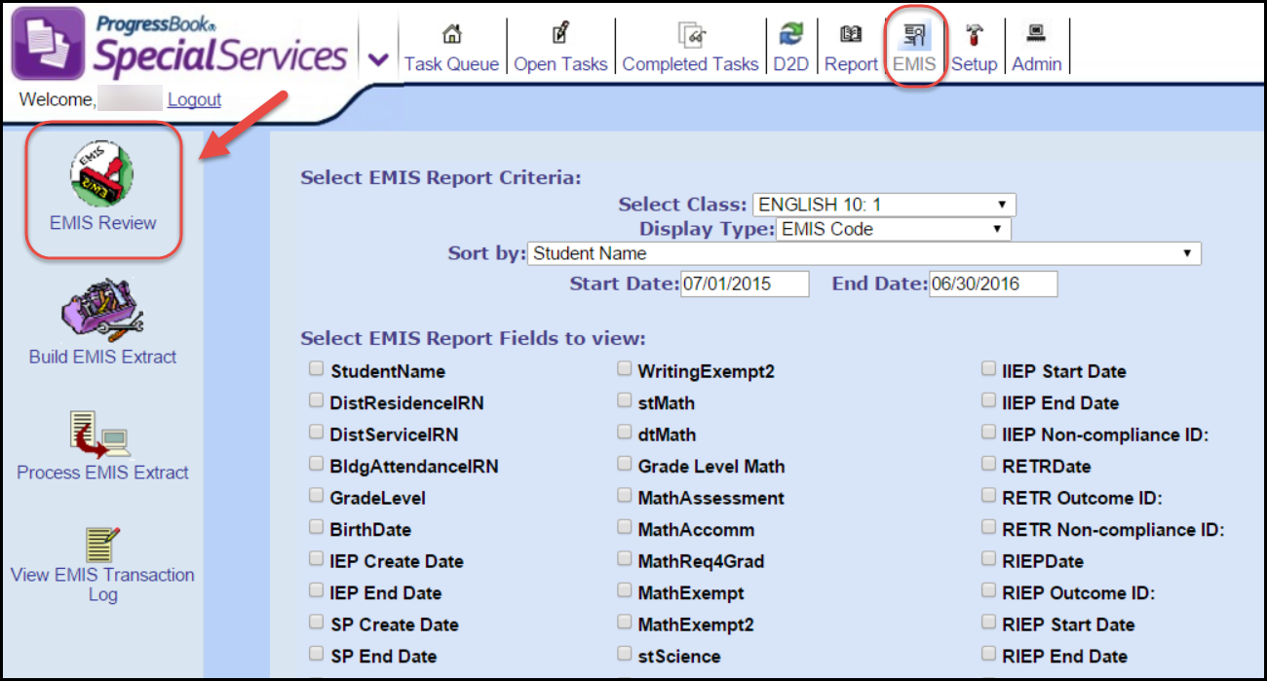
v15.3.0 SpecialServices Enhancements
EMIS Review Report
Performance Improvement
The length of time allowed for the report to generate has been increased
Originally only allowed for approximately 2 minutes
Time has been extended to 10 minutes

Slide 4
v15.3.0 SpecialServices Issue Resolutions
Open Task
Ooopps Error, no longer displays
Occurred when opening certain forms
Saving Forms
All data is saved
Performance Enhancements
Completed Tasks
Performance has been improved
Class Print
Attempting to print forms for a large number of students
Additional time has been given up to 10 minutes
Completed Task
Switching Districts
Moving between Completed Tasks and Open Task
Is Successful without error

Slide 5
Thank you!

